Slide 1



Financial Statements with DAX in Power BI
Joseph Yeates
Notes:
Hello Everyone! My name is Joseph Yeates and I’m excited to present:
Financial Statements with DAX in Power BI

Slide 2



Financial Statements with DAX
Joseph Yeates
www.feathersanalytics.com
@FthrsAnalytics
in/josephyeates237
Notes:
I am a Senior Financial Analyst, Business Intelligence & Data Analysis at Corporate Finance Institute
I am passionate about driving better decision making by creating, curating and communicating insights from data.
I am a data enthusiast leveraging Microsoft Power BI, SQL Server, and R Studio to model, manipulate, analyze, and visualize data.
My website is Feathers Analytics .com, where I blog about all things Power BI and R
but most importantly – how to bring the different strengths of these tools together to build powerful solutions that provide actionable insights.
My twitter and linkedin profiles are there, I really enjoy connecting with the analytics and BI communities

Slide 3
Financial Statements with DAX
Agenda
What are Statements?
Create the Data Model
Create Custom Mapping
Create Financial Statements

Slide 4
Financial Statements
Income Statement
Balance Sheet
Cash Flow Statement

Slide 5

Income Statement
Displays performance over a given period
Revenues and expenses are measured to assess profitability

Slide 6
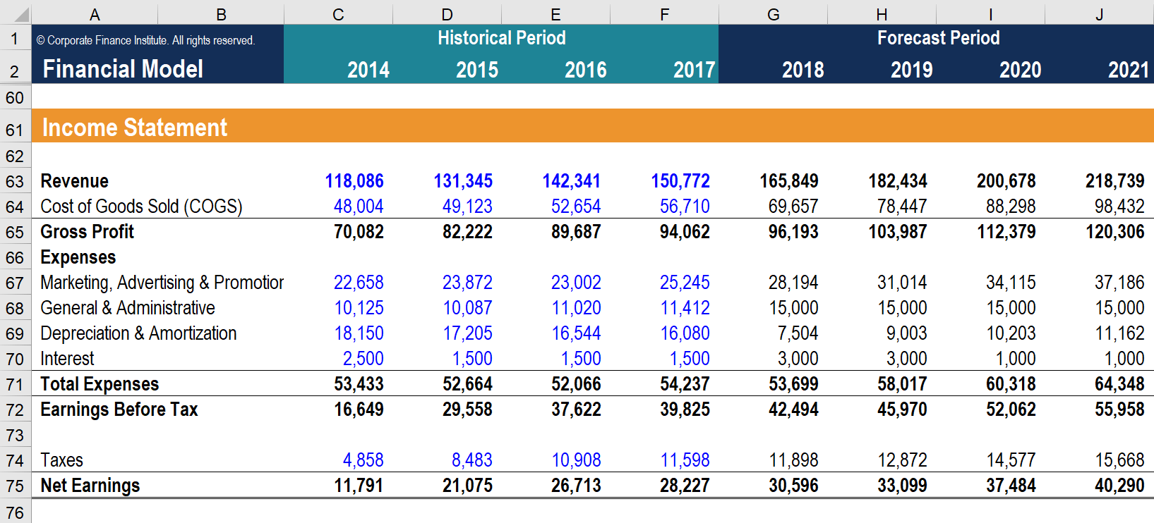
Income Statement
Image: CFI’s Financial Modeling Courses

Slide 7

Balance Sheet
Displays financial position at a given time
Assets equal Liabilities plus Shareholders’ Equity

Slide 8
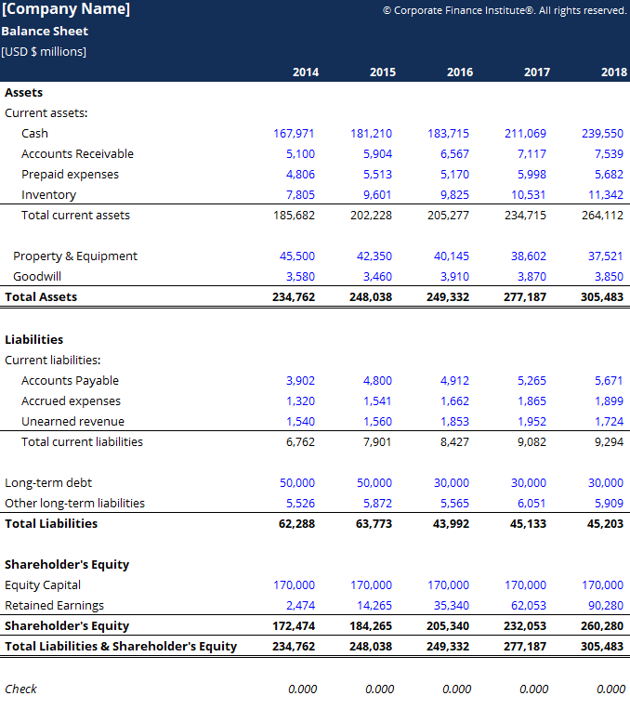
Balance Sheet
Image: CFI’s Financial Analysis Course

Slide 9

Cash Flow Statement
Displays cash movements over a given period
Cash from operations, investing, and financing are measured to show net change

Slide 10
Cash Flow Statement
Image: CFI’s Financial Analysis Fundamentals Course

Slide 11
Create the Data Model

Slide 12
Business Scenario
We have been tasked with creating the latest annual income statement, with information from the accounting system. However, the statement requires some additional information that is more granular than the accounting system holds.
Notes:
This is the scenario we will be addressing through the presentation.

Slide 13
Create the Data Model
Source System - GL Account Balances
Source System – GL Account Categories
List of GL Accounts to Remap
List of GL Accounts to Remove
Custom – GL Account Categories

Slide 14
Create DAX Measures
Data Analysis Expressions (DAX)
DAX measures aggregate data to return a single value
DAX provides the ability to explicitly control the filtered context of a measure

Slide 15
Create Mapping Table

Slide 16
Create Mapping Table
Reference existing Headers in Category table
Insert Rows with = Table.InsertRows()
Add Sort Column
Notes:
Remove duplicates and keep the rows that we need for headers
Insert new rows into our headers table using the

Slide 17
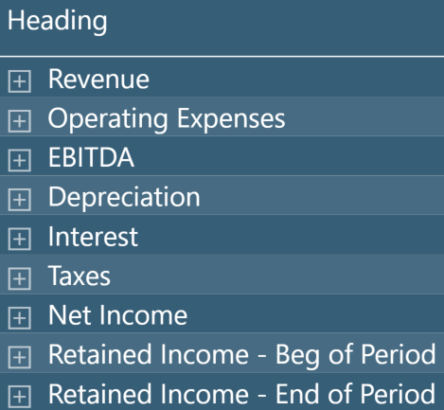
Create Mapping Table

Slide 18
Income Statement

Slide 19
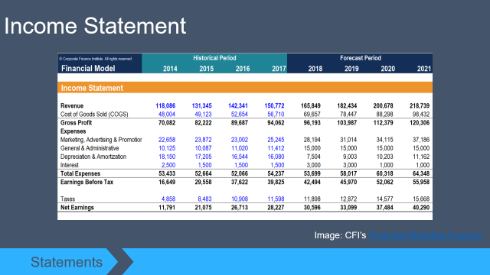
Income Statement
Build a measure to populate the empty Headers template and create the Income Statement
Quick review of Income Statement

Slide 20
Current Balance
Current Balance
= GL Source Total + Remap Total + Remove Total
This can populate the GL categories from the source system.
What about the new categories?

Slide 21
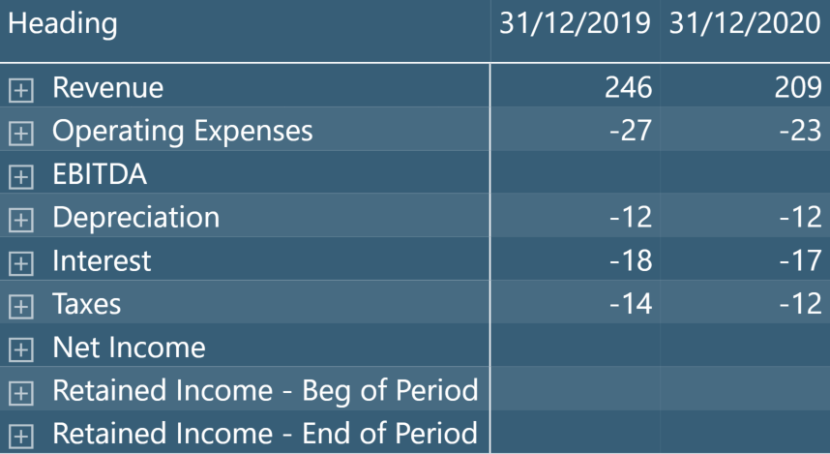
Others Measures

Slide 22
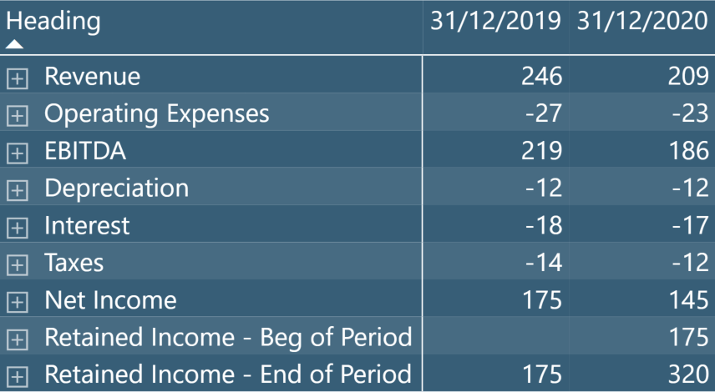
Others Measures

Slide 23
Others Measures
Subtotal
Cumulative Total
Previous Period Cumulative Total
SWITCH() to bring them all together
Notes:
EBITDA & Net Income
End of Year Net Income – all current year and all previous years as well
Beg of Year Net Income – want the end of year from previous period to display

Slide 24
Others Measures
= CALCULATE()
Notes:
EBITDA & Net Income
End of Year Net Income – all current year and all previous years as well
Beg of Year Net Income – want the end of year from previous period to display

Slide 25
Others Measures
= CALCULATE(Measure, Modified Context)
Notes:
EBITDA & Net Income
End of Year Net Income – all current year and all previous years as well
Beg of Year Net Income – want the end of year from previous period to display

Slide 26
Others Measures
= CALCULATE(Measure, Modified Context)
Two arguments:
Measure to modify
How to modify the filtered context of the measure
Notes:
EBITDA & Net Income
End of Year Net Income – all current year and all previous years as well
Beg of Year Net Income – want the end of year from previous period to display

Slide 27
Financial Statements with DAX
Joseph Yeates
www.feathersanalytics.com
@FthrsAnalytics
in/josephyeates237

